Slide 1
Dask
Out-of-core and distributed data analysis in Python

Slide 2
About this talk
Many thanks to Sudo!
Introduction to Python data ecosystem
Introduction to Dask as an out-of-core data analysis package
Distributed: Dask on a heterogeneous cluster
Live music demo

Slide 3
About me
Bachelor of Computer Science, UWA, 2014
B. Information Technology (Honours), ANU, 2015
Project: Improving Image Understanding with Concept Relation Graph
Data analyst @ Seeing Machines
Scientific Python since 2014
My recent talk on Python’s import mechanism:
https://goo.gl/J1fcDH
Notes:
UWA: which is in Western Australia
Data Analyst: and Python software engineer GitHub: I don't do much with repositories for now, but I like Gists.

Slide 4
Python data ecosystem
A data scientist’s perspective
Notes:
I’ll do the introduction in two ways. The first is to show the stack from a historic perspective, and where Dask fits in it. The other way is what problems a data scientist needs to solve in production, what tools will he/she need, and how Dask can help data scientists to solve their problems better.

Slide 5
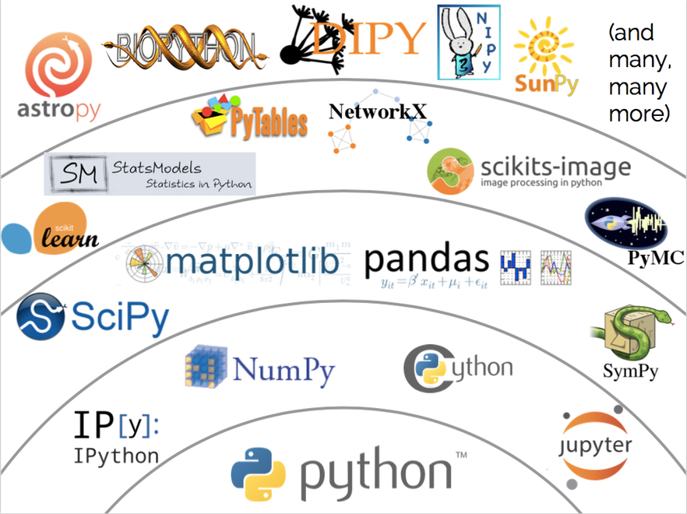
Python data stack
Python
NumPy, Cython, iPython
SciPy, SymPy, Pandas, matplotlib, Jupyter
scikit-learn, StatsModels, scikits-image, NetworkX, PyTables, (Dask)
Domain-specific packages
Notes:
This picture represents the state of the stack in early 2015.
NumPy is a package that supports multi-dimensional numerical arrays. It's almost the foundation of all data analysis packages. It started in 1995 when Python was still at an early age, and had some influences on the language itself, especially the indexing syntax. Pandas is a package for 2-dimensional PANal DAta, like Excel. It is built on top of NumPy. It was started in 2008 by a quantitative analyst at a bank, but it quickly became the go-to package for tabular data because people have been using Excel for so long.

Slide 6
Bigger data requires scalability
Embarrassingly outdated assumptions:
There is only one core
The dataset fits in the memory
Two orthogonal directions of scalability:
Scaling up / vertically: joblib, Numba, HDF5
Scaling out / horizontally: PySpark, Dask
No. 1 enemy of scalability is I/O
“a supercomputer is a device for turning compute-bound problems into I/O-bound problems.”
Notes:
Assumptions: These two assumptions sound legitimate when NumPy and Pandas were born, but the size of dataset has grown significantly over the years. Now we generally consider “big data” as datasets that are too big to fit into the memory of one machine.
Scaling up: Adding resources to a single node, such as more CPU cores, GPUs, more disk storage, and make the system run faster accordingly.
Joblib: An early attempt in running Python functions as “jobs”. Most well-known for running embarrassingly parallel loops in parallel with little modification to sequential code.
Numba: This is really cool. A Just-in-Time compiler from numerical Python code to LLVM intermediate representation. In numerical Python, we always have the problem of a fast algorithm implemented in Python being slower than a slow algorithm implemented in C. Cython was the first attempt to tackle this problem. It allows users to add C-styled annotations to numerical bottleneck functions, then Cython compiles those code into C. Numba is more restricted in terms of what code can be compiled, but the source of compilation is pure Python, so it’s easier to write, and runs faster.
HDF5: A storage format for large numerical datasets. It allows users to load a subset of the dataset into the memory, so we can work on datasets bigger than the memory. (Sounds like back to the 1970s?)
Scaling out: Adding more nodes, and make the system run faster accordingly.

Slide 7
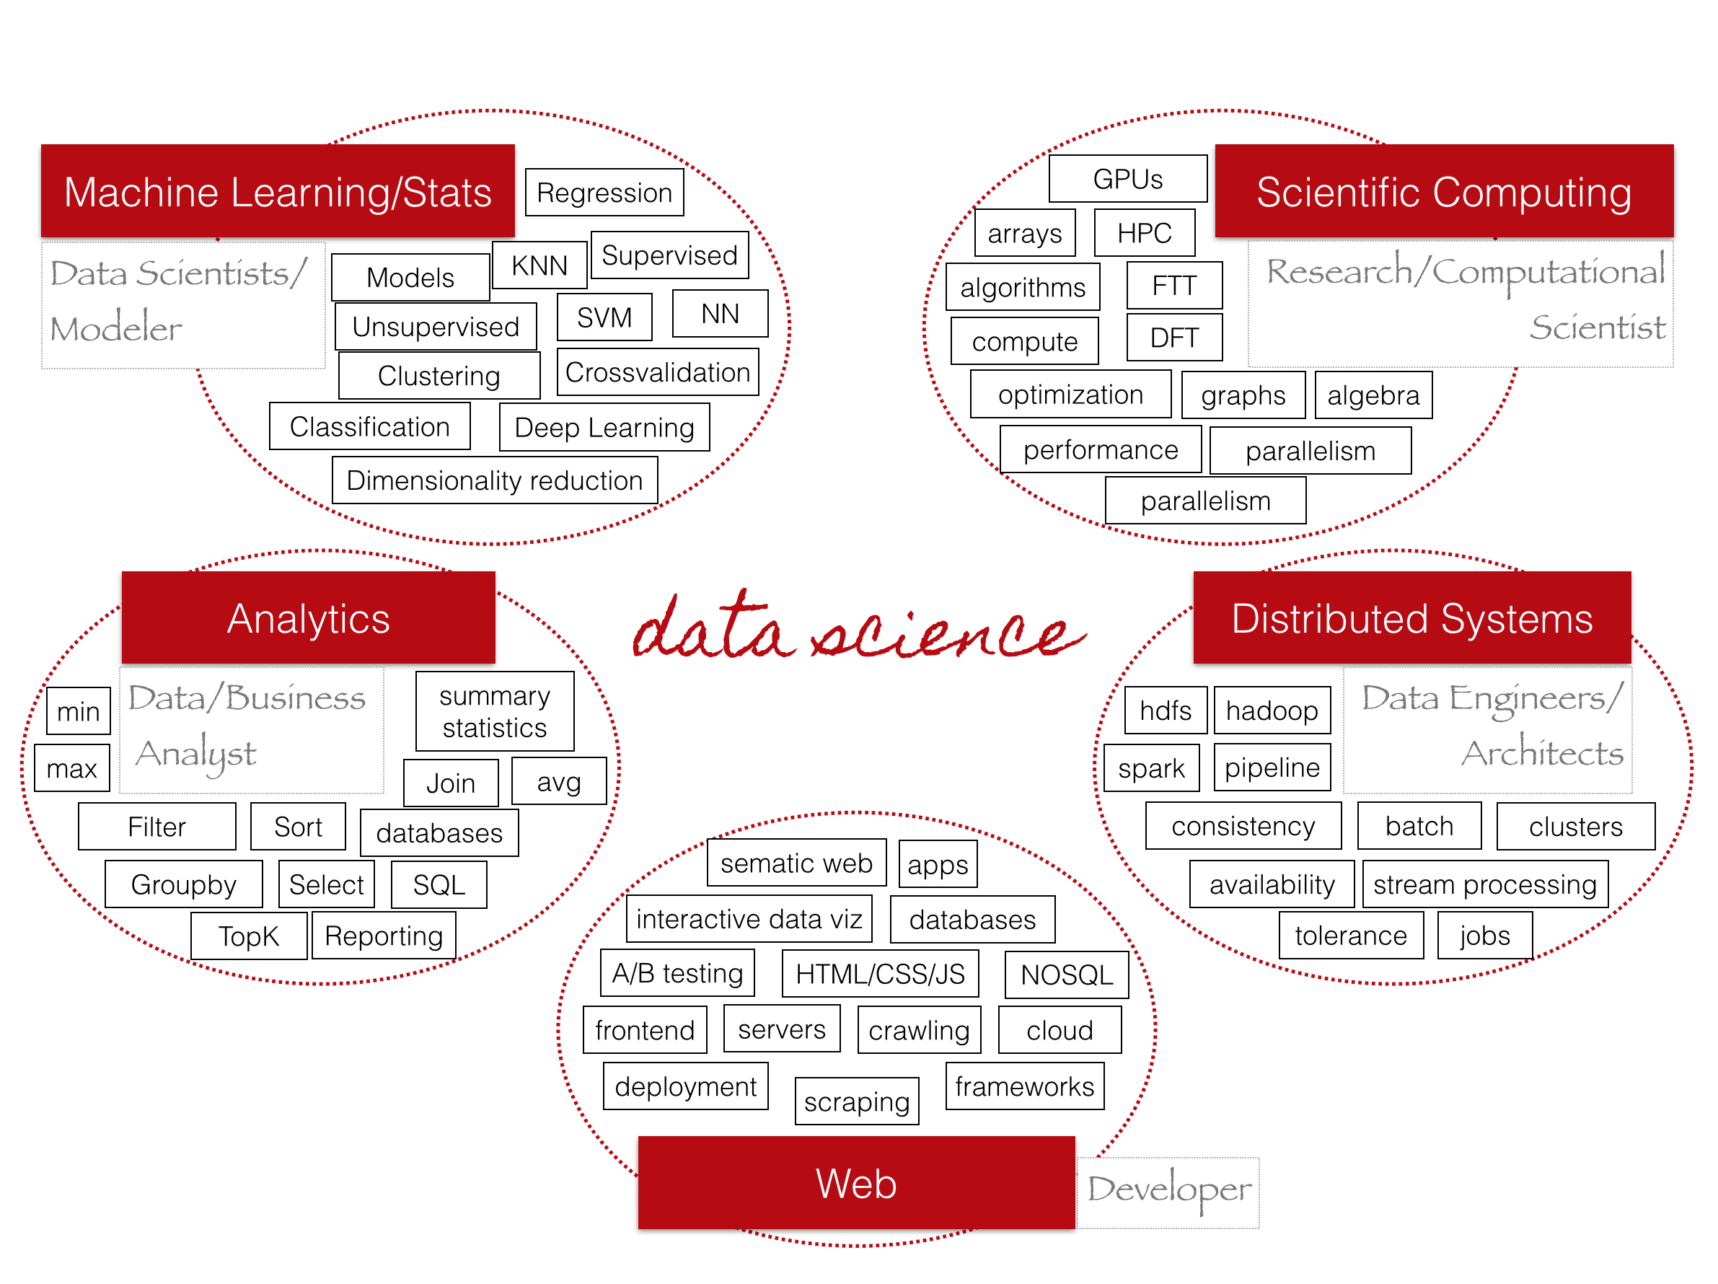
Notes:
You might notice that the color scheme has changed here. I took this chart from Christine Doig’s EuroPython 2015 talk “Scale your data, not your process”. There will be a link at the end of this talk.
Note that areas on this slide are not necessarily mutually exclusive.

Slide 8
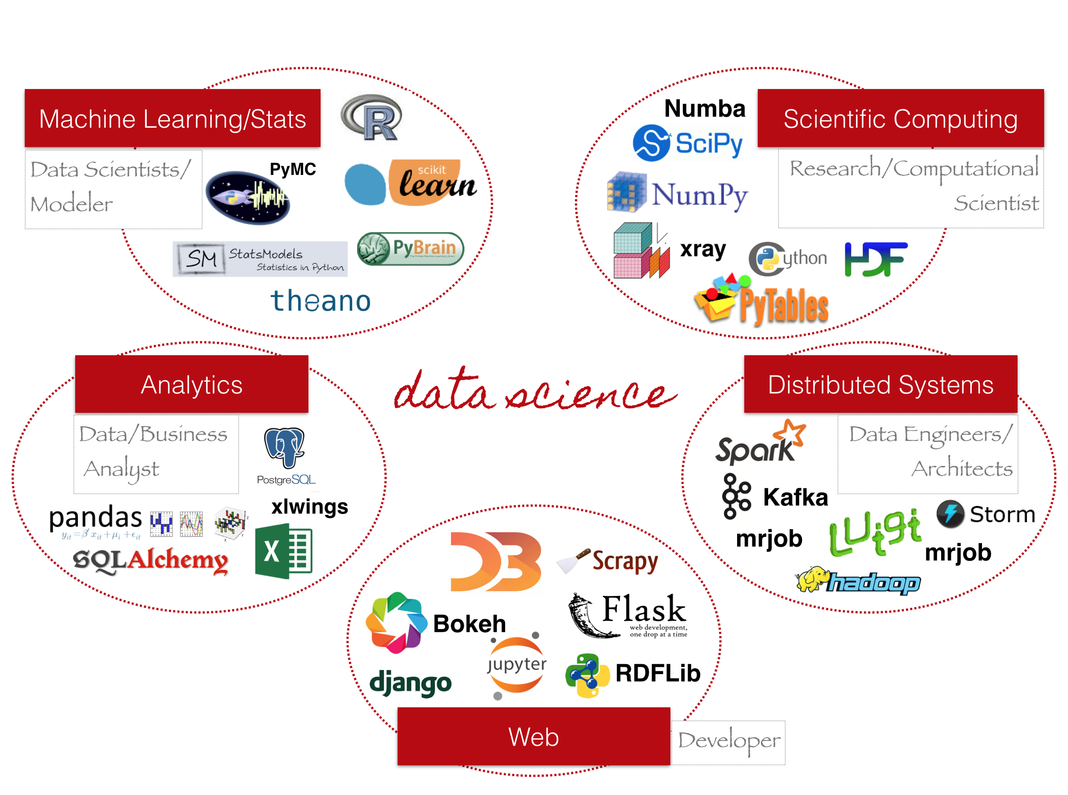
Notes:
Dask fits in Analytics, Scientific Computing, and Distributed Systems.

Slide 9
Introduction to Dask
An out-of-core data analysis tool in Python

Slide 10
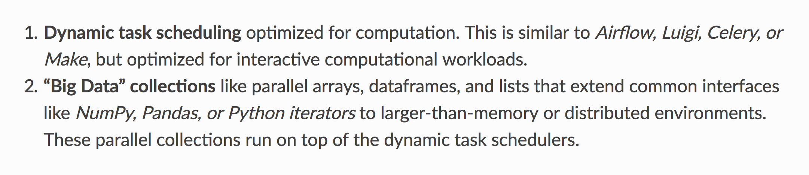
Two systems put together
Notes:
This definition is taken from Dask’s official documentation.
Optimised for interactive workloads: Dask is designed towards low latency, away from massive scalability. If you want to scale to 5,000 nodes, Spark is a better choice.
“Big Data” collections: The second point is really just a by-product of the first.
Extend common interfaces: This refers to the fact that Dask wraps NumPy NDArray and Pandas DataFrame internally, and provides a very similar interface on a higher level.
larger-than-memory: This is why I used the term “out-of-core”.

Slide 11
Installing Dask
Install with pip:
pip install dask[complete] distributed graphviz
Install with conda:
conda install dask distributed python-graphviz
Demo environment:
python==3.6.4
dask==0.17.1
distributed==1.21.3
graphviz==2.40.1
Notes:
I strongly recommend the conda package manager. Pip can only handle Python packages, but conda can handle C/Fortran bindings as well.

Slide 12
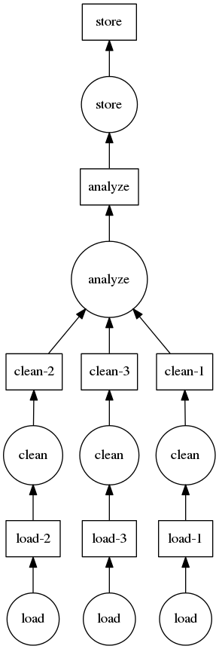
Computation graph
A DAG of data blobs and lazy-evaluated functions
In this example: circles are functions, rectangles are data
Data, functions, and the computation graph are all arbitrary
No need to follow the map-reduce paradigm
Schedulers run through a computation graph according to its topological order
Assuming that functions have no side effects
Notes:
Computation graph sits at the very core of the Dask dynamic scheduling mechanism.
Arbitrary: Computation graph is not new to Dask. Spark does the very same thing; but the Dask computation graph is much more fine-grained than Spark’s, so Dask does not have to follow the map-reduce paradigm. We’ll see an example later.
Side effects: If functions are pure, then we can have multiple schedulers running concurrently, and it doesn’t matter who does what. Things are more complicated when functions have side effects. (You can see that the computation graph borrowed many ideas from functional programming!)
This example still follows the map-reduce paradigm. We have to finish computing clean-1, 2, and 3 before we can call function analyze to “reduce” the data. After calling analyze, we are limited to a single thread only.

Slide 13
Computation graph
task = {
'load-1': (load, 'myfile.a.data'),
'load-2': (load, 'myfile.b.data'),
'load-3': (load, 'myfile.c.data'),
'clean-1': (clean, 'load-1'),
'clean-2': (clean, 'load-2'),
'clean-3': (clean, 'load-3'),
'analyze': (analyze, ['clean-%d' % i for i in [1, 2, 3]]),
'store': (store, 'analyze')
}
Notes:
... and here’s how this computation graph is represented. Just a simple dictionary.

Slide 14
Notes:
You can call this “graph-oriented programming” or “dataflow-oriented programming”. Because the scheduler is aware of the life cycle of each data blob, intermediate results can be thrown away once they are no longer needed (shown in blue here), or written to disk if we are running out of memory. This allows Dask to piecewisely run tasks that cannot fit into the memory at once. We’ll see more benefits of graph-oriented programming when we talk about the distributed scheduler.

Slide 15
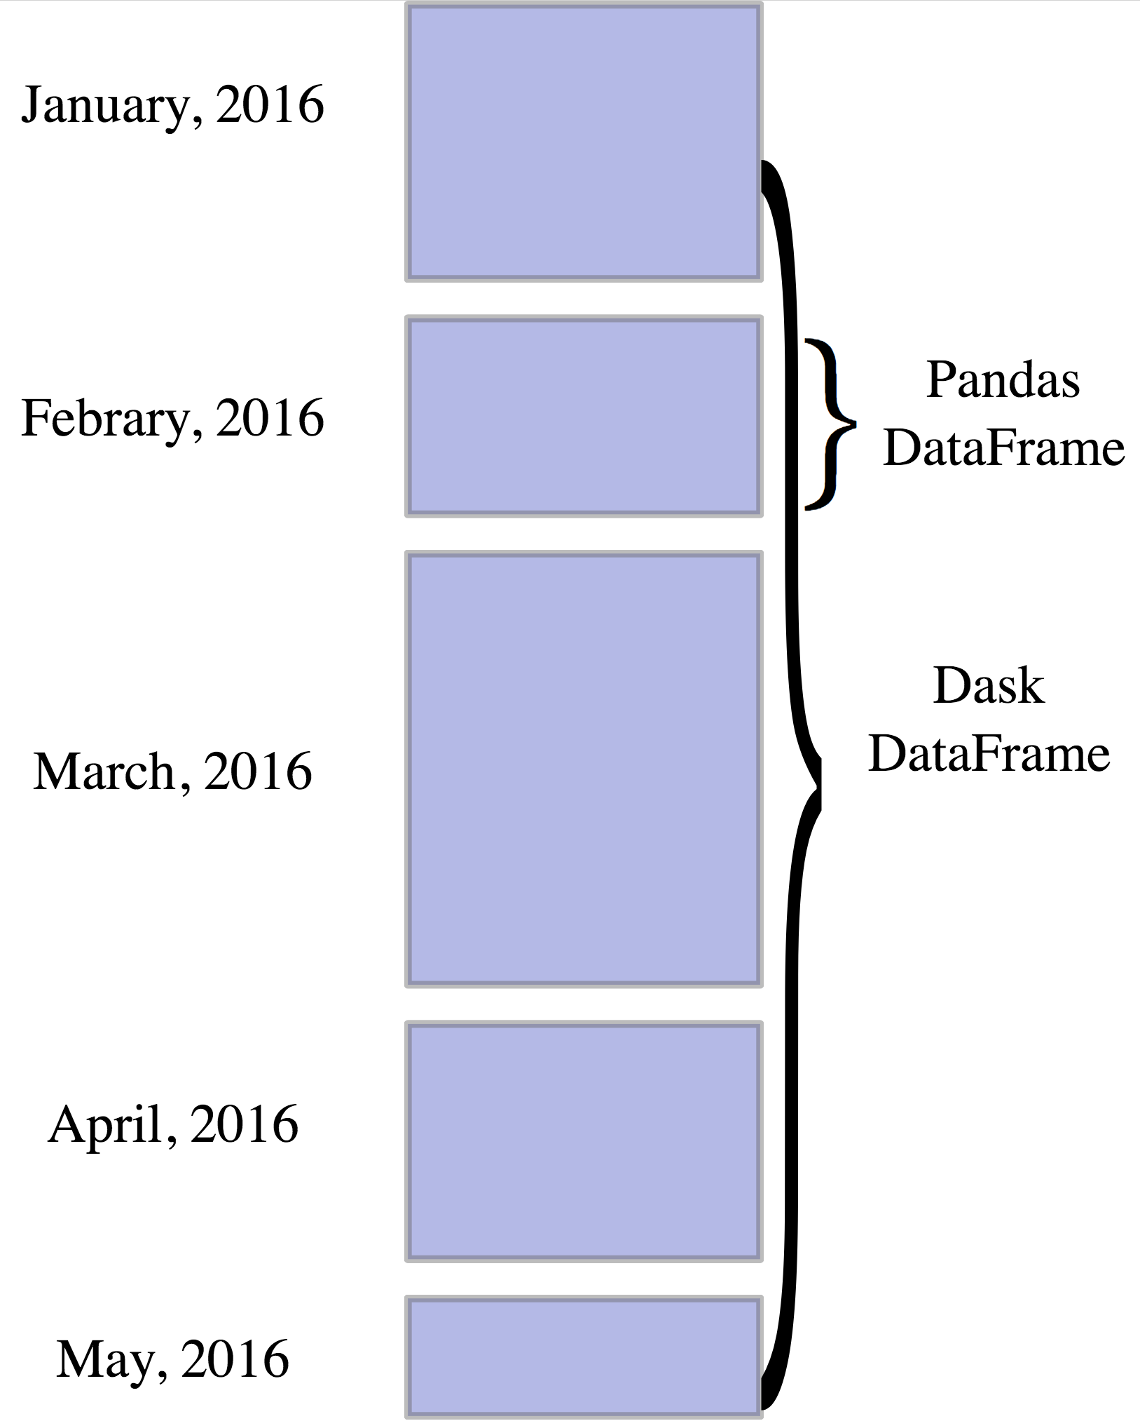
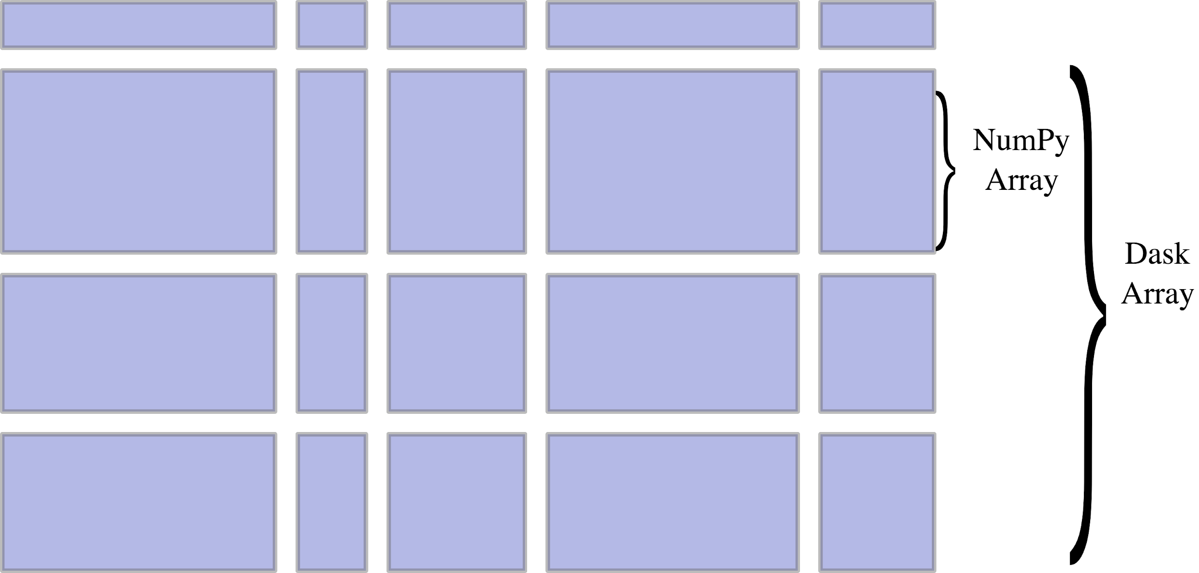
Dask DataFrame Dask NDArray
Notes:
If we put chunks of NumPy array or Pandas dataframes into it, we get an out-of-core version of NumPy or Pandas. Dask does very little computations here. Most of the time, it coordinates NumPy or Pandas to work on their native data structure.
Obviously, chunking on indices does not make sense everywhere. In the DataFrame case, we can imagine a large time series dataset, in which each month’s data can fit in the memory, but we need the hard drive to store the entire dataset. And in the NDArray case, we can imagine the two axis are longitude and latitude, respectively.
Apart from NDArray and DataFrame, Dask also has a Bag type, which is the chunked version of Python list. It is the most general Dask data structure. Recently, Dask has added an experimental API for custom distributed data structures, so I expect to see more data structures added in the future.

Slide 16
Schedulers
Shared memory schedulers:
single-thread: Best for debugging
multithreading: Best for numerical computation that releases the GIL
multiprocessing: Best for parallel computation that holds the GIL
Distributed scheduler: Designed for a cluster, but also works well on a single machine
Comes with monitoring interface
Scheduling overhead grows linearly with the size of computational graph
200µs overhead for each task node, and an 1ms overall startup time
Notes:
GIL: A CPython-specific mechanism preventing multiple threads from executing Python bytecodes at the same time. This lock is necessary mostly because CPython's memory management is not thread-safe. GIL can be released in most Cython/Numba-accelerated numerical code because we are not running Python bytecodes there.
Multiprocessing: Much higher startup overhead compared to single-thread and multi-thread scheduler.
Distribute scheduler: On a single machine, the distributed scheduler may run faster than the multiprocessing scheduler when the computation graph is complex. This is because the multiprocessing scheduler can only communicate via the master process, whereas the distributed scheduler can communicate between workers via message passing.
We’ll revisit the distributed scheduler after the demo.

Slide 17
Demo
Google Map distance queries from JSON to DataFrame

Slide 18
Dask.Distributed
Dask on a heterogeneous cluster

Slide 19
Distributed scheduler
Separate package from Dask
slightly extended computation API
Run on single machine, local cluster, and cloud
Built-in support for managed cluster, e.g. Kubernetes
Client - scheduler - workers structure
One scheduler process, many worker processes
Resilient to changes in workers, but not the scheduler
Unified interface for the client regardless of the scheduler - workers setup
Notes:
Separate package: Distributed was developed after Dask. Dask runs comfortably without distributed.
One scheduler, many workers: They are all separate Python processes, communicated over the network, so it doesn’t matter where they are. Such a setup has benefits and downsides.
Resilience on workers: Workers can be added and removed on the go, and workload is balanced automatically.

Slide 20
Performance is data locality
Network I/O is hugely expensive
Usually cheaper to move computation than data
Distribute data before computation if possible
The scheduler works in such a way that network I/O is minimised
Thanks to computation graph and much heuristics
Users still need to be very aware of where data is
Side note: Shared-memory schedulers minimise memory footprint
Notes:
Distribute data before computation: This has two meanings. First, if possible, store your data source on all nodes locally to avoid concurrent access to the centralised storage. Second, if an intermediate result will be used in further operations, it’s a good idea to persist your intermediate data on the distributed memory.
Minimise I/O in the scheduler: The scheduler can do so because it is aware of the size of each data blob in the computation graph. But even so, the user still need to be aware of how much data is being moved. And Dask will raise warnings if too much data is being transferred over the network.

Slide 21
Correctness is data consistency
Identical execution environment on client, scheduler, and workers
Use pure function whenever possible
Unpure functions must be explicitly marked, and must be idempotent
If unpure, Dask has to coordinate such that exactly one instance is executed with an input
Notes:
Idempotent: Repeated calls does not affect the result.
Identical execution environment: In other words, the same command should return the same result on any point in the system, unless explicitly specified.

Slide 22
Demo
JSON to DataFrame on a local cluster

Slide 23
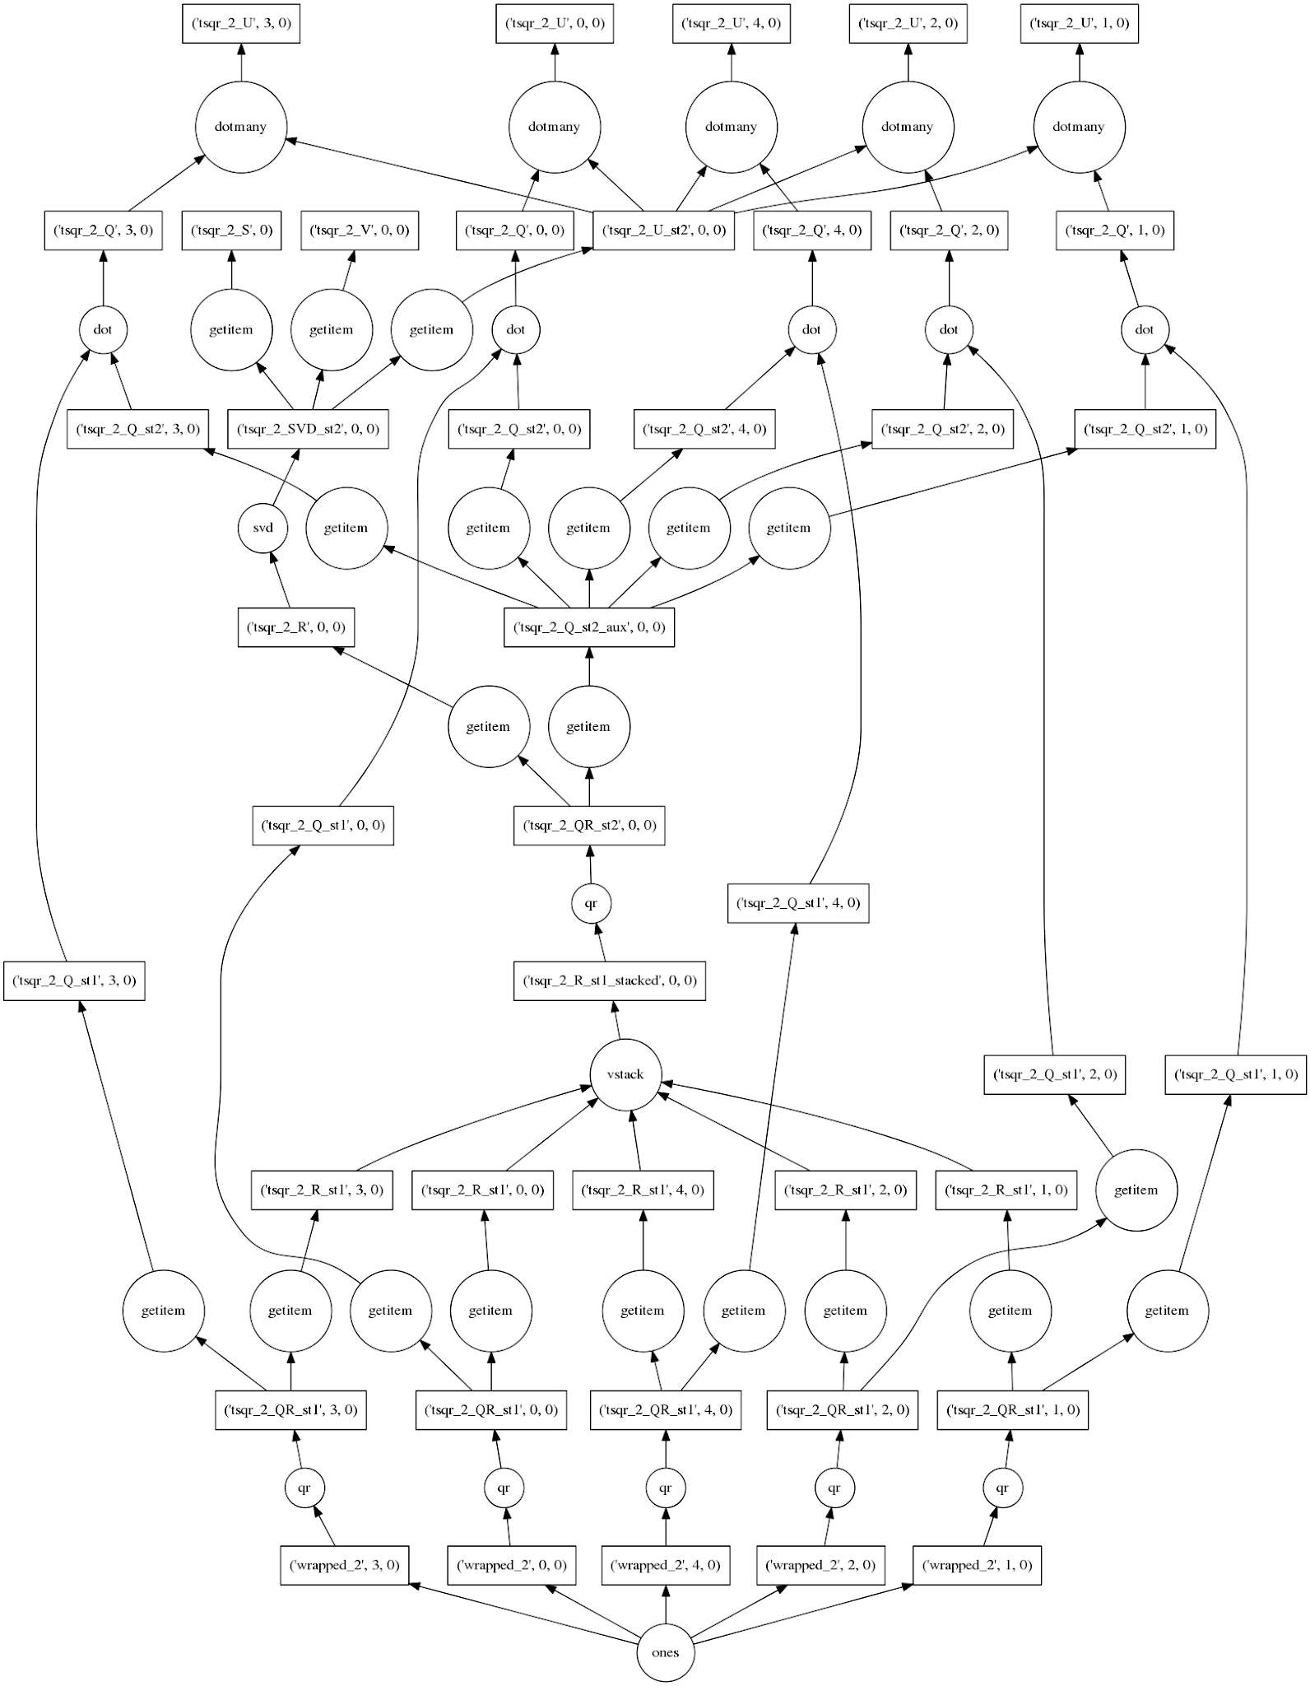
Thank you
Feel free to Dask any questions!
Contact me:
andyinlibo@gmail.com
github.com/liboyin
facebook.com/libo.yin.1

Slide 24
Further reading
Dask documentation
https://dask.pydata.org/en/latest/
Dask.distributed documentation
https://distributed.readthedocs.io/en/latest/
Matthew Rocklin’s Dask development blog
https://matthewrocklin.com/blog/
Dask: A Pythonic Distributed Data Science Framework
https://www.youtube.com/watch?v=RA_2qdipVng
Scale your data, not your process
https://www.youtube.com/watch?v=QKBcnEhkCtk

